Slide 1


Python Fundamentals
Innovation Masters
Day 10

Slide 2
Lists
Almost all sorts of data are always stored in a list, in programming and in real life.
Examples: student records, grocery list, syllabus, transaction ledger (incomes and expenses), etc.
Why are lists helpful?
Organized
Ease of retrieval (sorting)
Efficient
Follows a systematic procedure

Slide 3
Lists in programming
You can visualize a list as a box with compartments
Syntax of declaring a list
my_list = [1, 3, 7] my_list = [ ] (can be empty too)
Each of the object has an index number, like we have for strings.
Do not store data/objects of different types together. Python allows you to do so but don’t do it.
Name
Data

Slide 4
List Methods
Now you will learn like a real programmer
There are several methods in lists that you yourself will find what they do.
Look up “Python list methods” and you will try each of the method
Here is a website that I found useful
https://www.w3schools.com/python/python_ref_list.asp

Slide 5
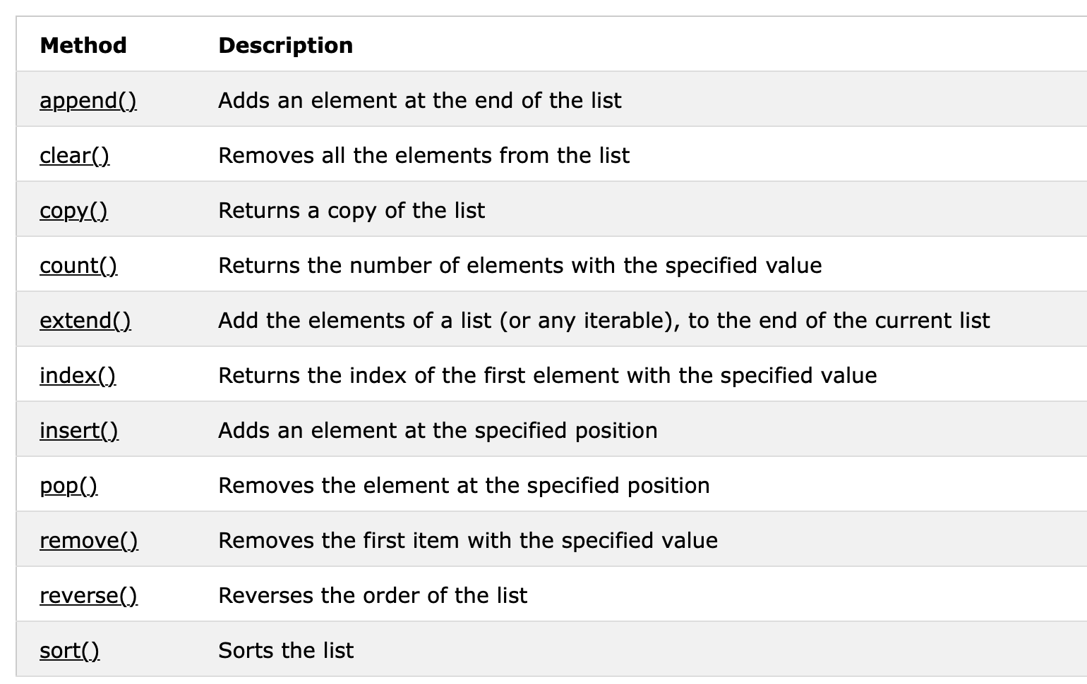
List Methods

Slide 6
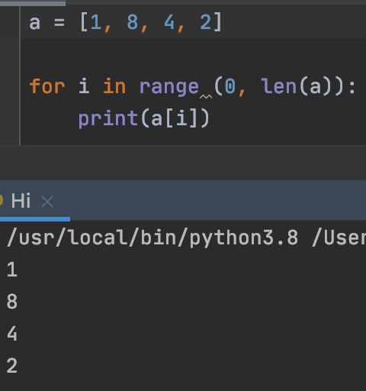
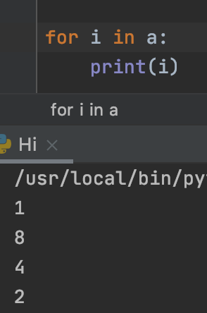
Iterating over a list
len(my_list) – how many objects are stored in the list
We can use for loops to iterate lists

Slide 7

Average calculator
Use a list to store a collection of student grades (0 – 100)
Take the average of the grades
Print the sorted list and the average grade
Formula for taking average:
(sum of all numbers) / (number of objects)
Ex: find average of 2, 5, 7, 1, 3
(2+5+7+1+3) / (5)

Slide 8
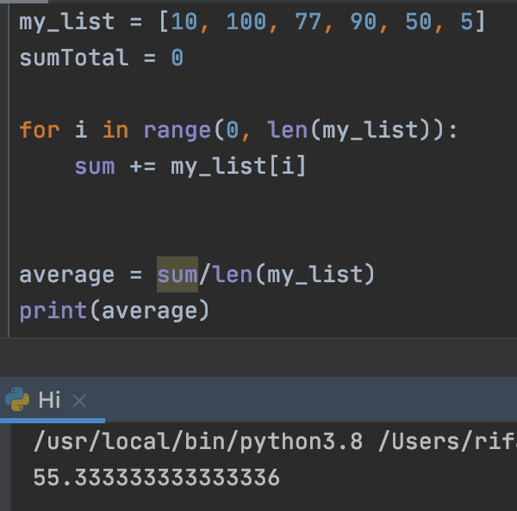
Solution

Slide 9

Practice problem
Max finder (2 implementations)
Take an unsorted list and find the maximum number from it
Find max without using the sort( ) method, hint: use for loop

Slide 10
Tech Talk
Kurzesagt ant

